Slide 1

Sony and their stocks
How did their acquisition of companies affect their stock value?

Slide 2

Some background of why I chose this subject
One of my favorite games has come under fire for their own decisions.
It was believe the changes came from their new parent company, Sony, but everything was internal.

Slide 3
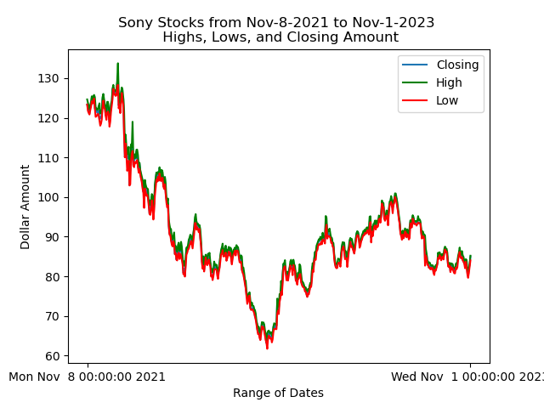
Not so good on the stocks
Sony’s stocks have been on downward trend since late 2021. These stocks represent Sony as a whole and not just their acquired businesses.

Slide 4
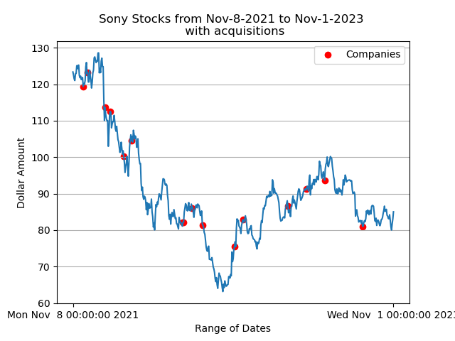
Not slowing down
Despite their stocks being on a downward trend, it seems this has not hampered their acquisition of companies.

Slide 5
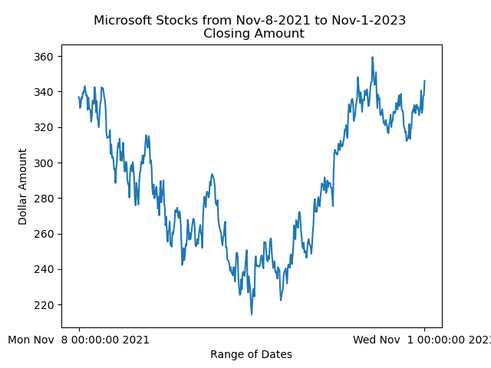
What about the competition?
While Microsoft took a dip in the beginning of 2022, their stock is on the rise.

Slide 6
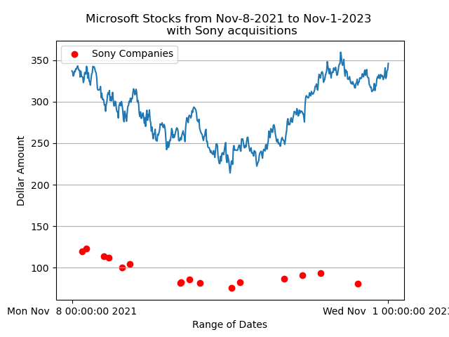
Not very effective…
So far, Sony’s acquisitions of certain companies has not affected Microsoft’s stock values.
Just like before, these values for Microsoft represent themselves overall.

Slide 7
In Conclusion
Despite Sony still acquiring companies, their stocks haven’t seem to go up.
The acquisitions held little to no effect on Sony’s stocks.
They certainly had no effect on Microsoft’s stocks
It’s possible Microsoft’s stocks might affect Sony’s stocks.

